Slide 1

Next.js 13
Your Odyssey into
Full Stack Mastery
SME: Sarthak S Kumar
MMStrava
Date: 07-10-2023
MONISHA SHARMA (PES2202300214)
MEGHANA BISA (PES2202300786)

Slide 2
Project Introduction/Abstract
MMStrava is a 3 part website consisting of the following:
- MMStrava Food Menu
- Split and Tip Calculator
- Payment Page

Slide 3
Project Applications/Innovation
Keeping the menu, followed by tip calculator and payment page really upgrades a regular restaurant menu.
Integrating these 3 parts:
1. Displaying menu and adding the items to the cart
2. Calculating the tip and split amount
3. Having a payment page
Makes it an all-in-one website

Slide 4
Project Features
MMStrava:
- Food Menu displayed
- Add to Cart Functionality
2. Tip Calculator
- Users will have to enter the amount displayed from the add to cart functionality, tip amount and number of people and the bill amount will be generated accordingly.
3. Payment Page
The payment page has 3 options. To be by cash, card or qr code and they will be directed to the respective pages accordingly.

Slide 5
Tech Stack and Tools Used
Technology and Tools Used:
HTML, CSS, JAVASCRIPT
2. Postman
3. Taken reference from Spoonacular API and its database
Sites Used:
Youtube
GitHub
Postman
spoonacular.com

Slide 6
Project Screenshots
MMSTRAVA HOMEPAGE

Slide 7
Project Screenshots
FOOD MENU

Slide 8
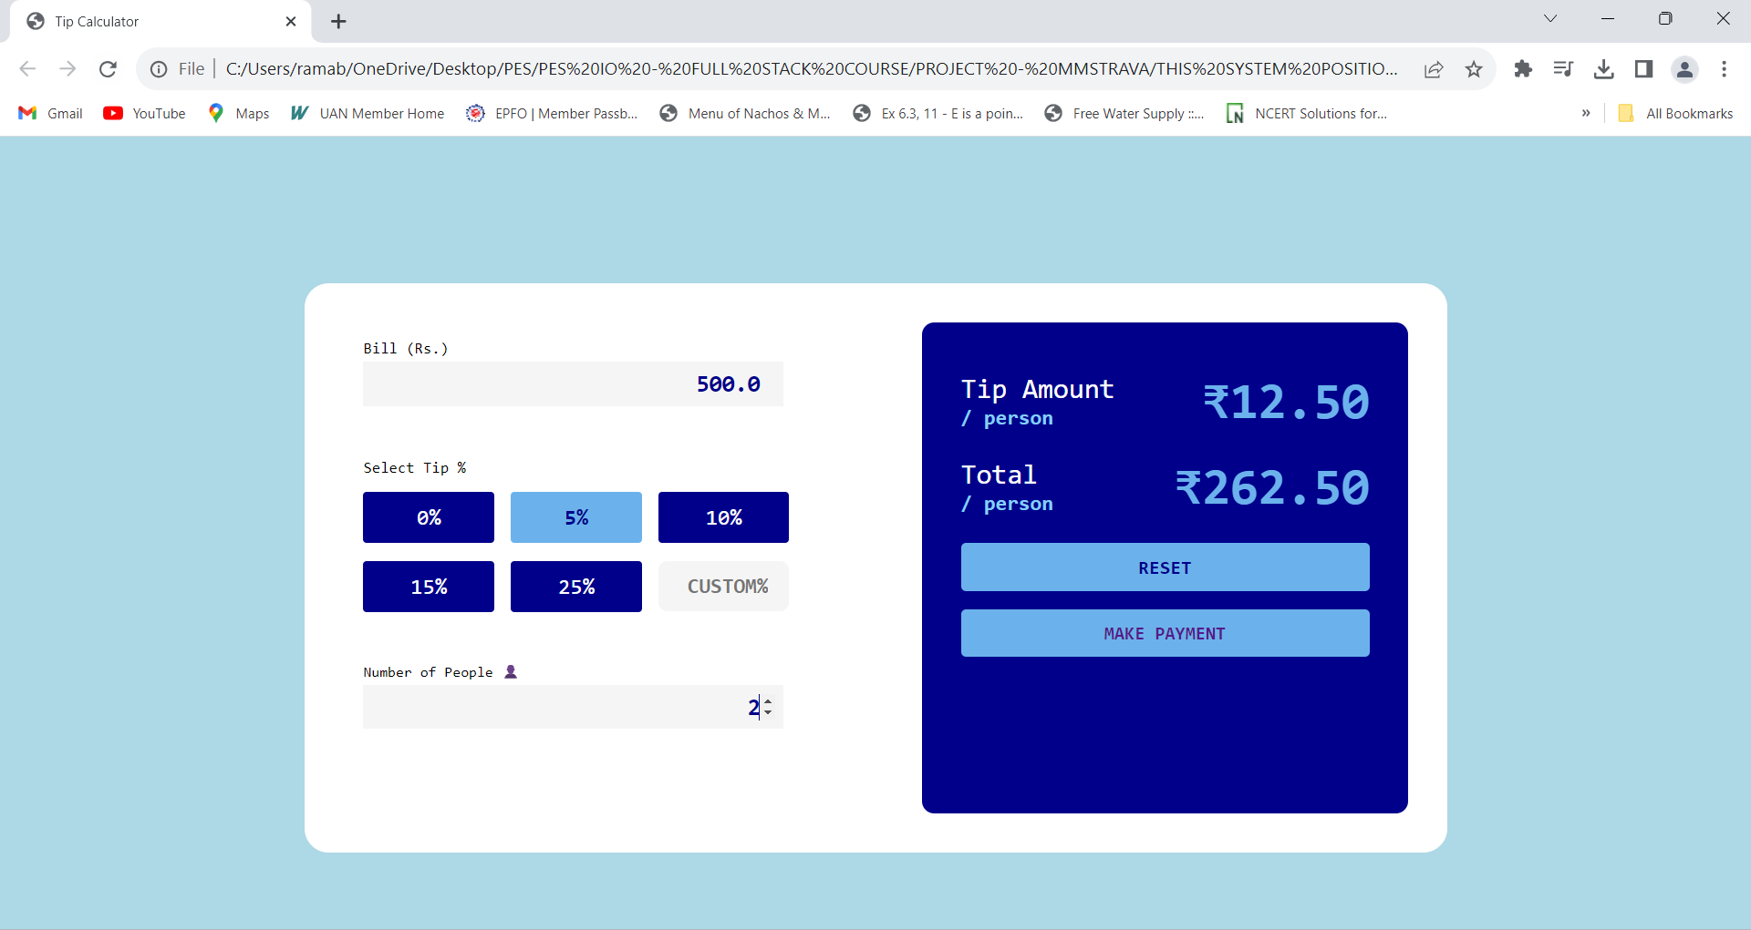
Project Screenshots
TIP CALCULATOR

Slide 9
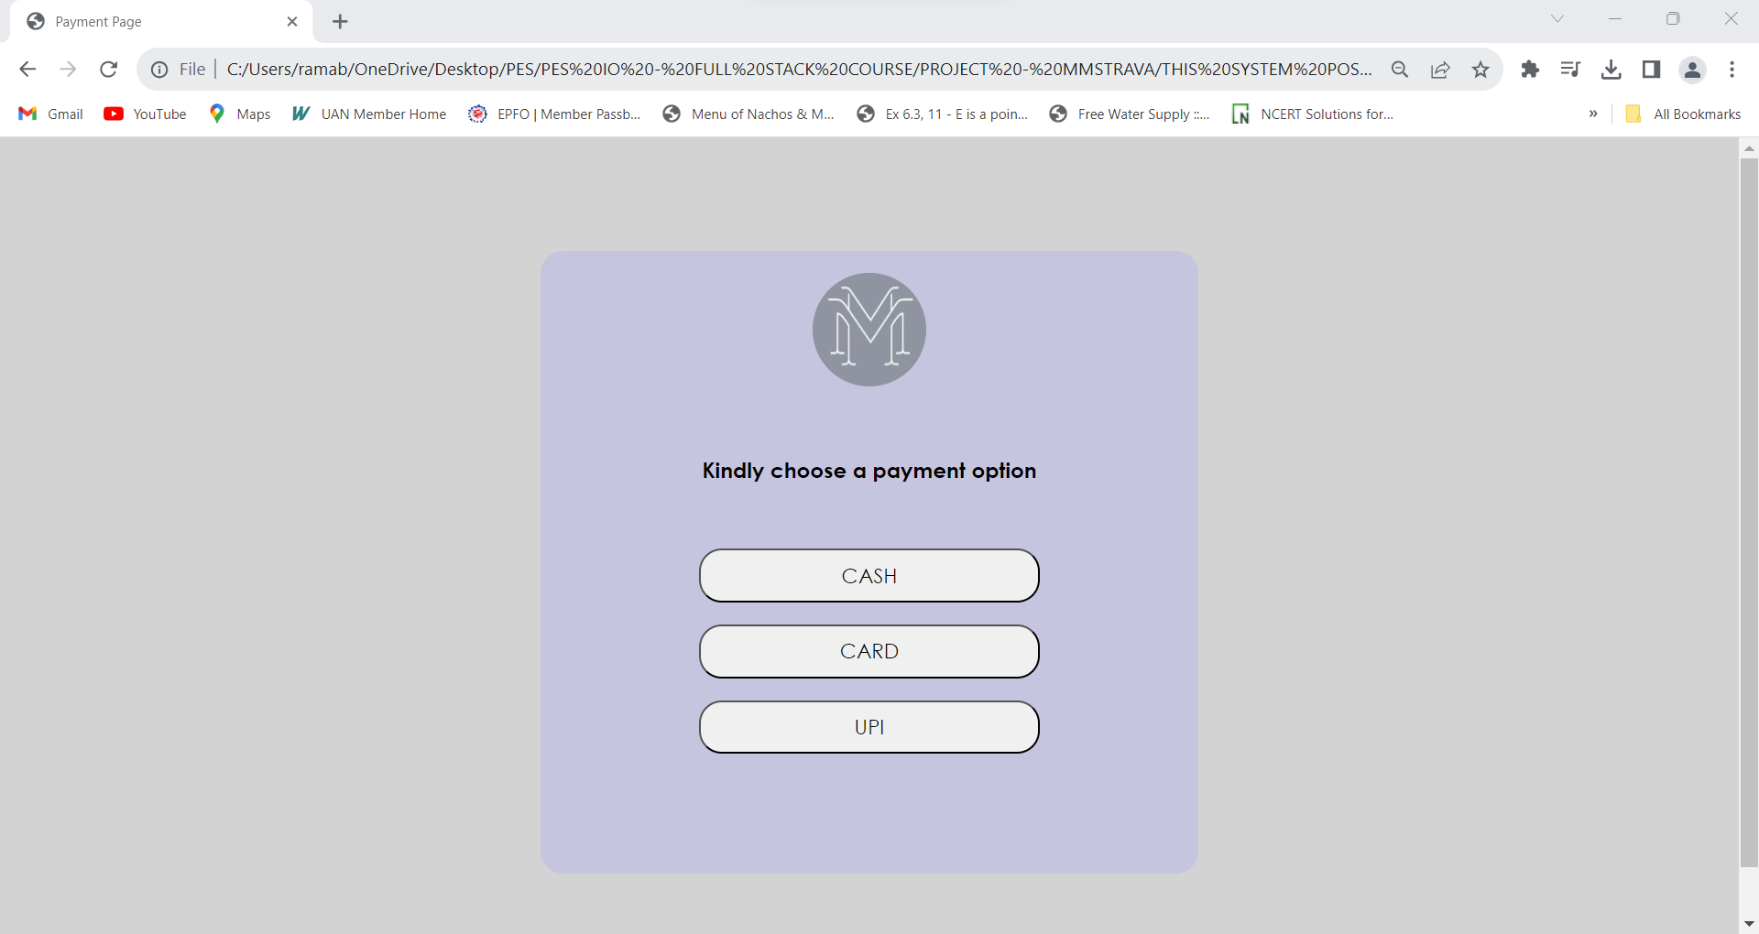
Project Screenshots
PAYMENT PAGE

Slide 10
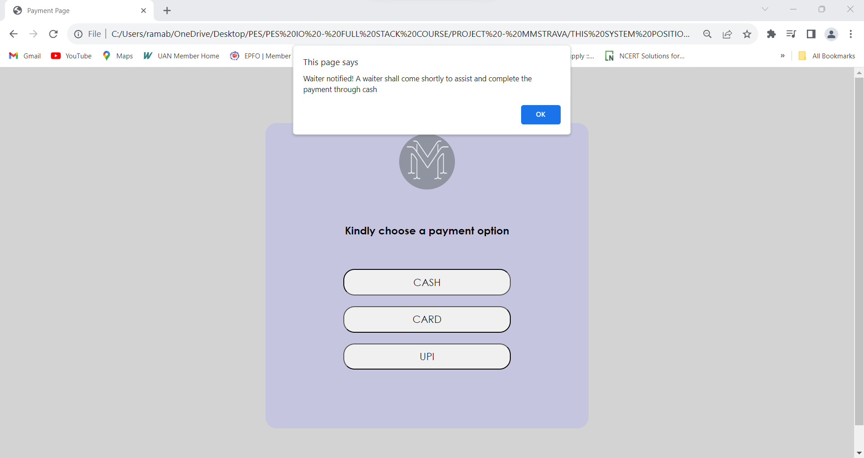
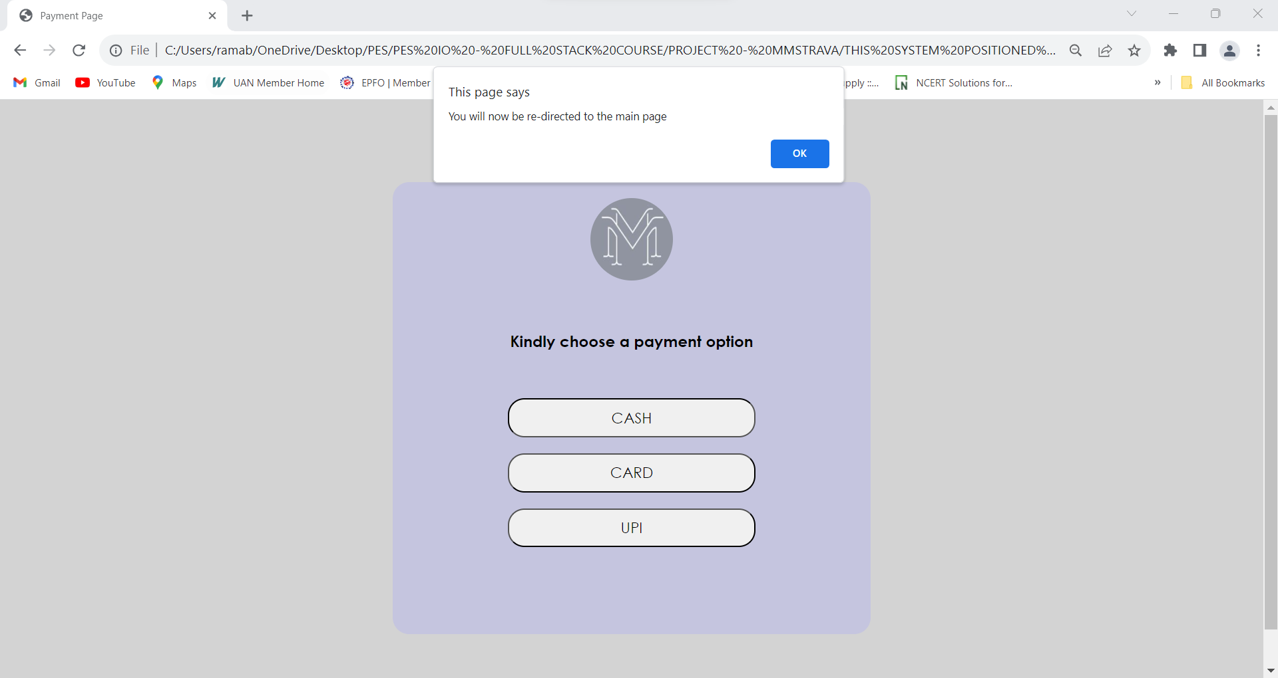
Project Screenshots
PAYMENT PAGE - CASH

Slide 11
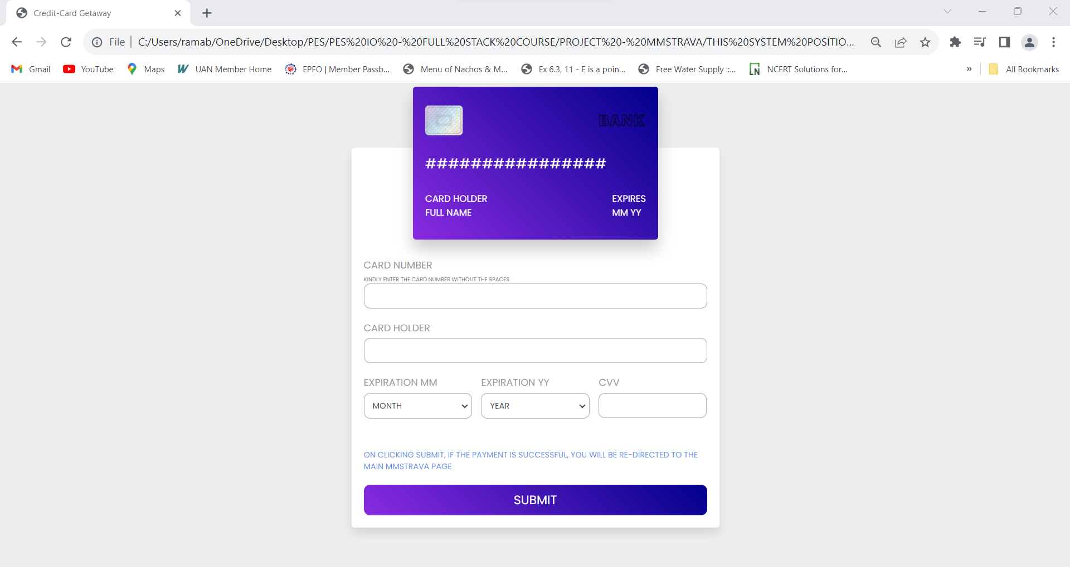
Project Screenshots
PAYMENT PAGE – CREDIT CARD

Slide 12
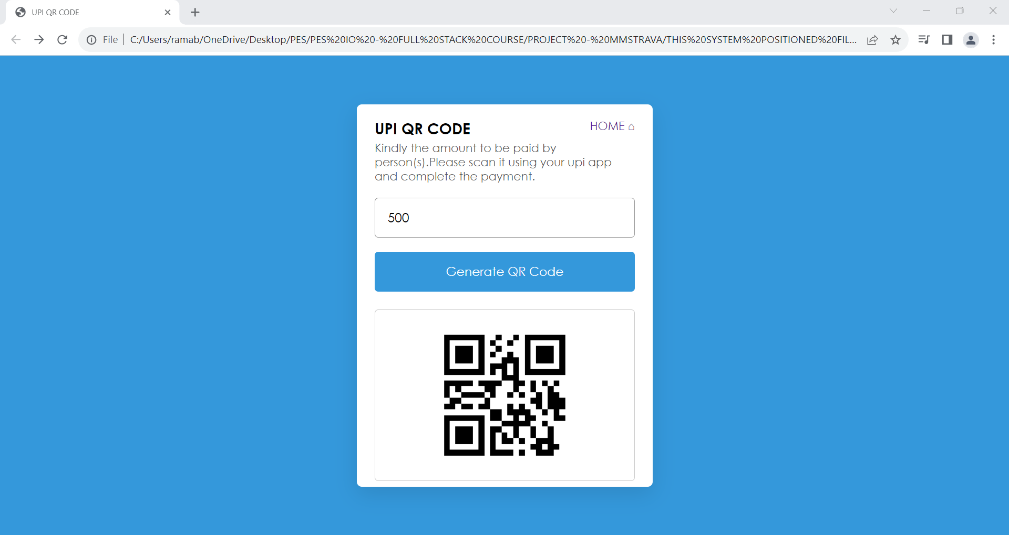
Project Screenshots
PAYMENT PAGE –QR CODE

Slide 13
Project Structure and Effort
MMSTRAVA HOME PAGE
DISPLAYING & VIEWING MENU
ADDING ITEMS TO CART
TIP AND SPLIT CALCULATOR
PAYMENT PAGE
Both the team members have put equal contribution and effort in this project.
The time spent in making this project is
15 (days) * 4 (hours) = 60 hours

Slide 14
Thank You

